Slide 1
MOLECULAR PROPERTIES
Sarita Charde Ph.D.
Data Scientist

Slide 2
01
TABLE OF CONTENTS
BIO
02
Study objectives
03
Define, Design & Delivery
04
CONCLUSIONS
All my journey so far!
Molecular structure
Data analysis and design of the model
Summary & Next steps

Slide 3

BIO
Education
Data Science
Ph.D. in Chemical Engineering
Experience
Data Analyst
Research Analyst
Skills
Visualization
Data mining
Deep Learning
GCP
Azure
AWS
MongoDB

Slide 4

“Walk up to a system and say, ‘I want to make this molecule.’
The software will tell you the route you should make it from & the machine will make it”
- Prof.Klavs Jense

Slide 5
01
TABLE OF CONTENTS
BIO
02
Study objectives
03
Define, Design & Delivery
04
CONCLUSIONS
All my journey so far!
Molecular structure
Data analysis and design of the model
Summary & Next steps

Slide 6
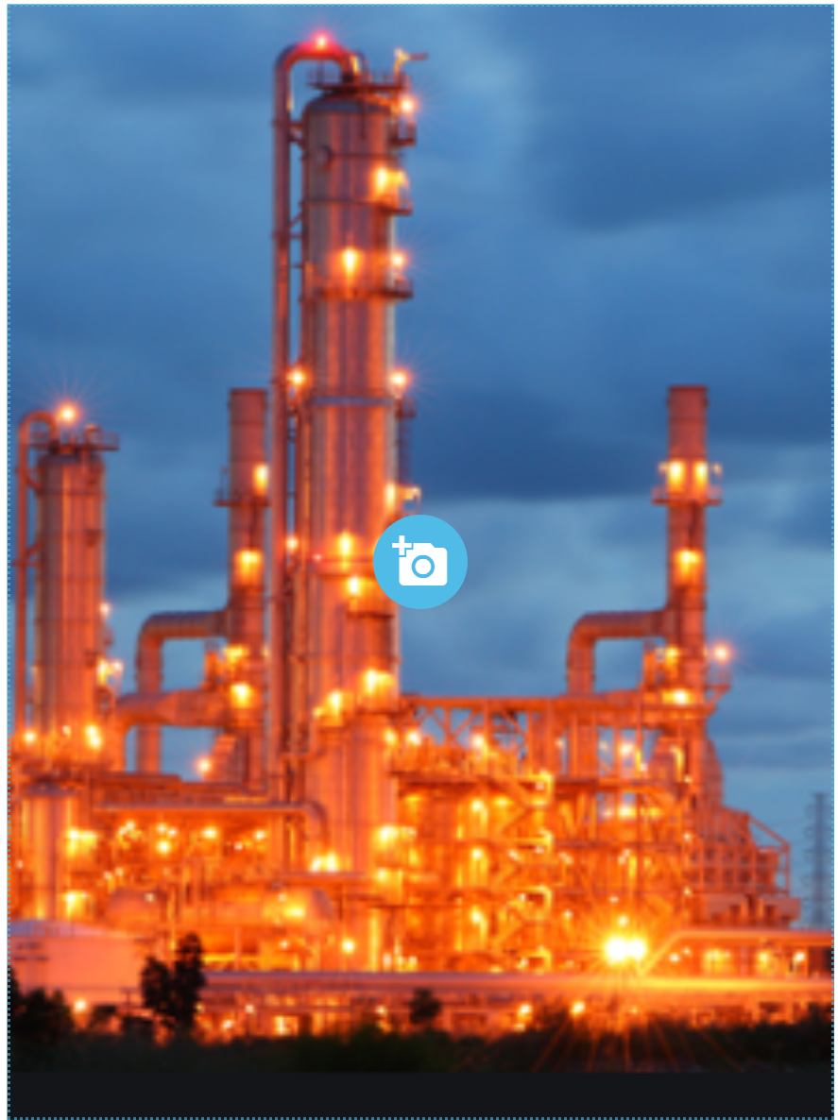
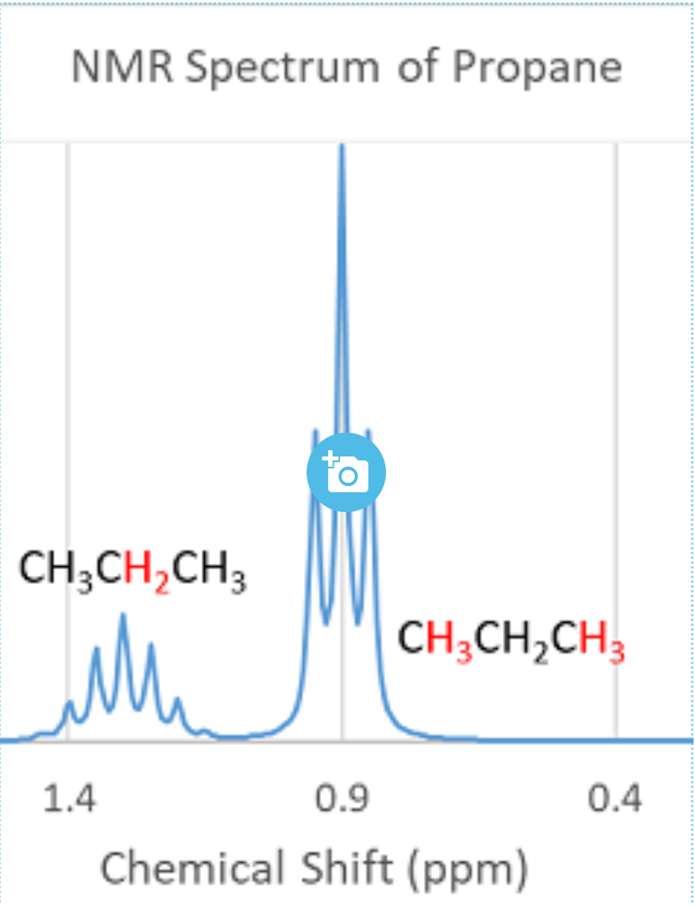

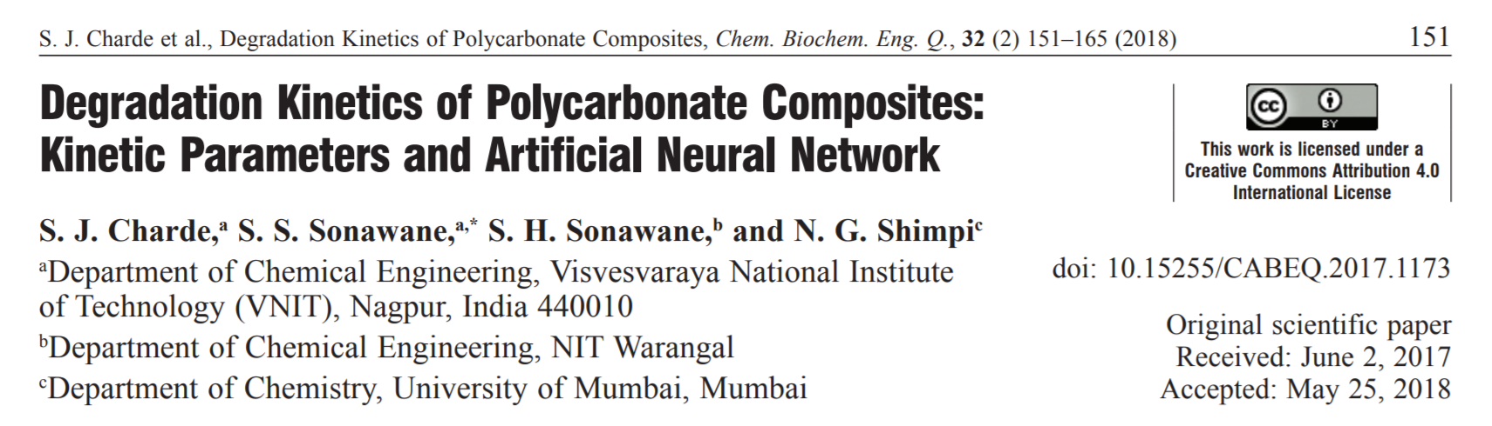
STUDY OBJECTIVES
DOMAIN
ANALYSIS
IMPORTANCE
Healthcare, Chemical & materials Engineering
Study and identify molecules
Prevent disease and invent new molecules

Slide 7
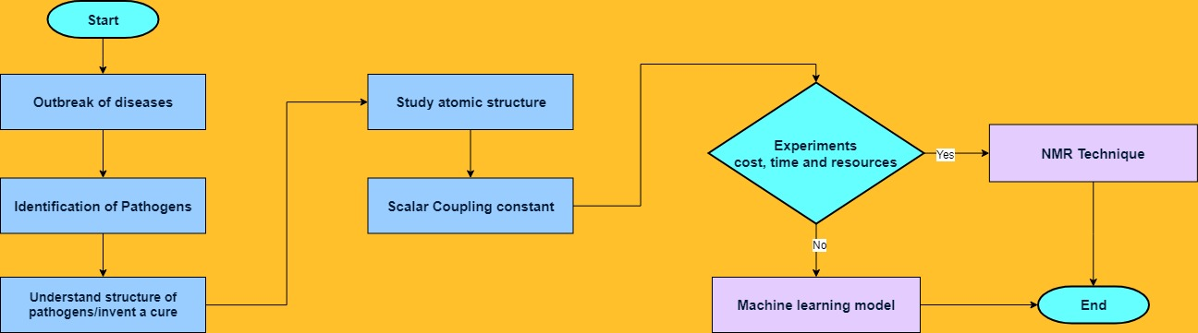
Process Flow

Slide 8
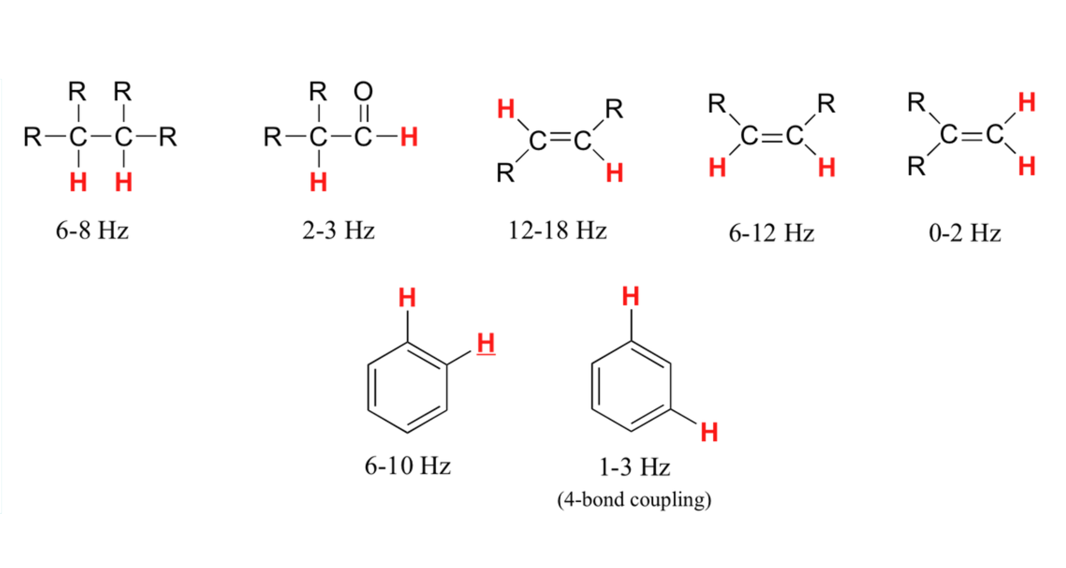
Scalar Coupling Constant Chart

Slide 9
01
TABLE OF CONTENTS
BIO
02
Study objectives
03
Define, Design & Delivery
04
CONCLUSIONS
All my journey so far!
Molecular structure
Data analysis and design of the model
Summary & Next steps

Slide 10
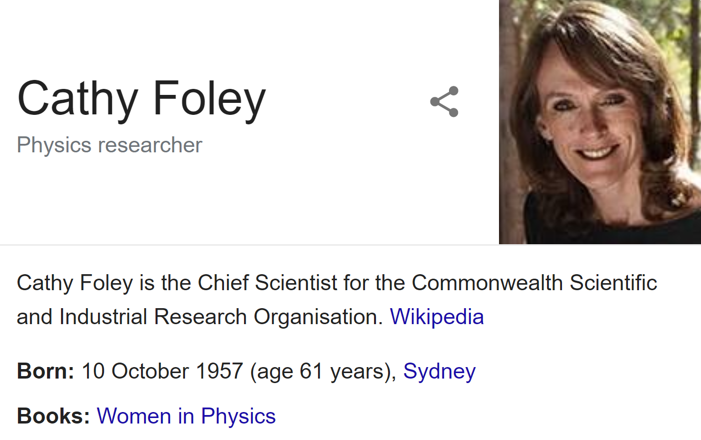
Business Question
What is the value addition if experimental techniques are replaced by computational techniques using existing data and infrastructure?

Slide 11
Business Value
Project aspects | R&D | Data Analysis
Cost of Equipment | $66,000 | nil
Materials Consumed | $59,000 | nil
Consulting fee charges | $100,000 | $150,000
Payment to researchers | $128,000 | nil
Indirect costs | $50,000 | $50,000
Total | $403,000 | $200,000
Projects executed | 10 | 50
Profitable Business

Slide 12

Data Question
How to get an approximation for structure and dynamics of molecules?

Slide 13
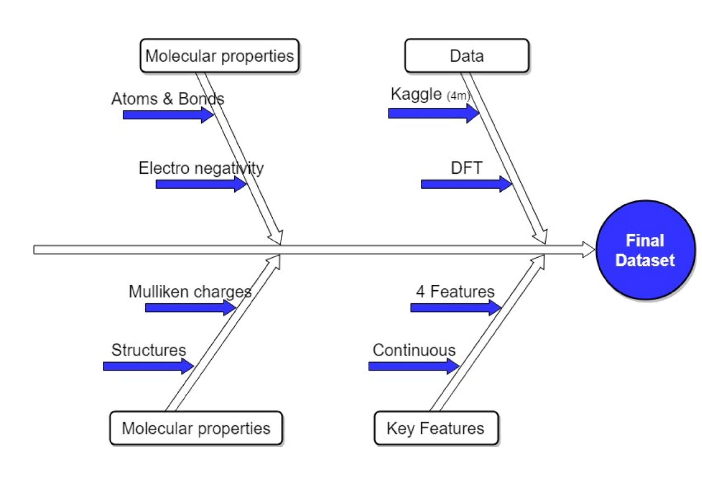
Data science aspects

Slide 14
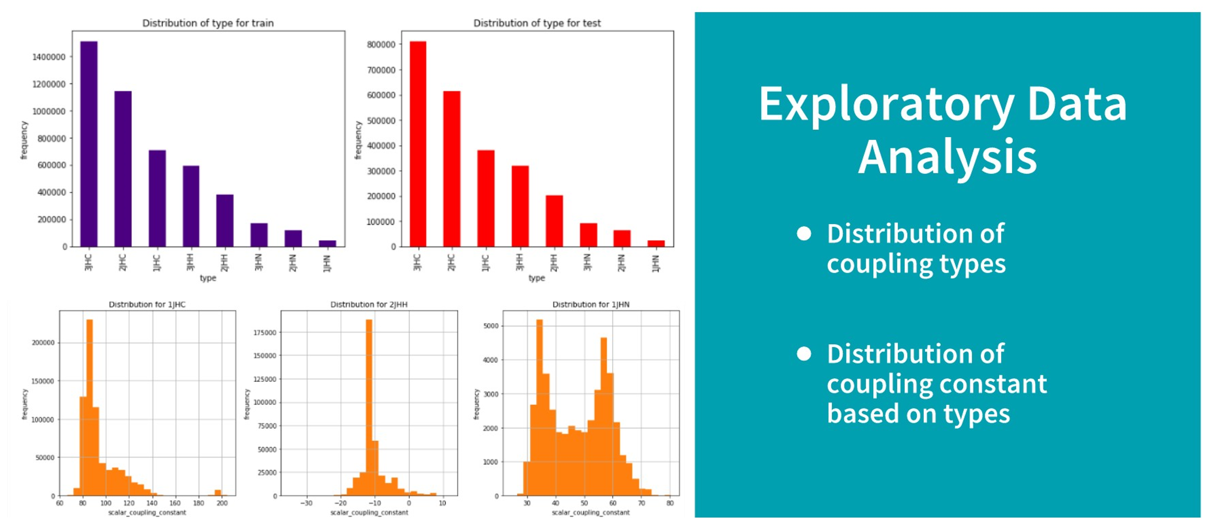

Slide 15
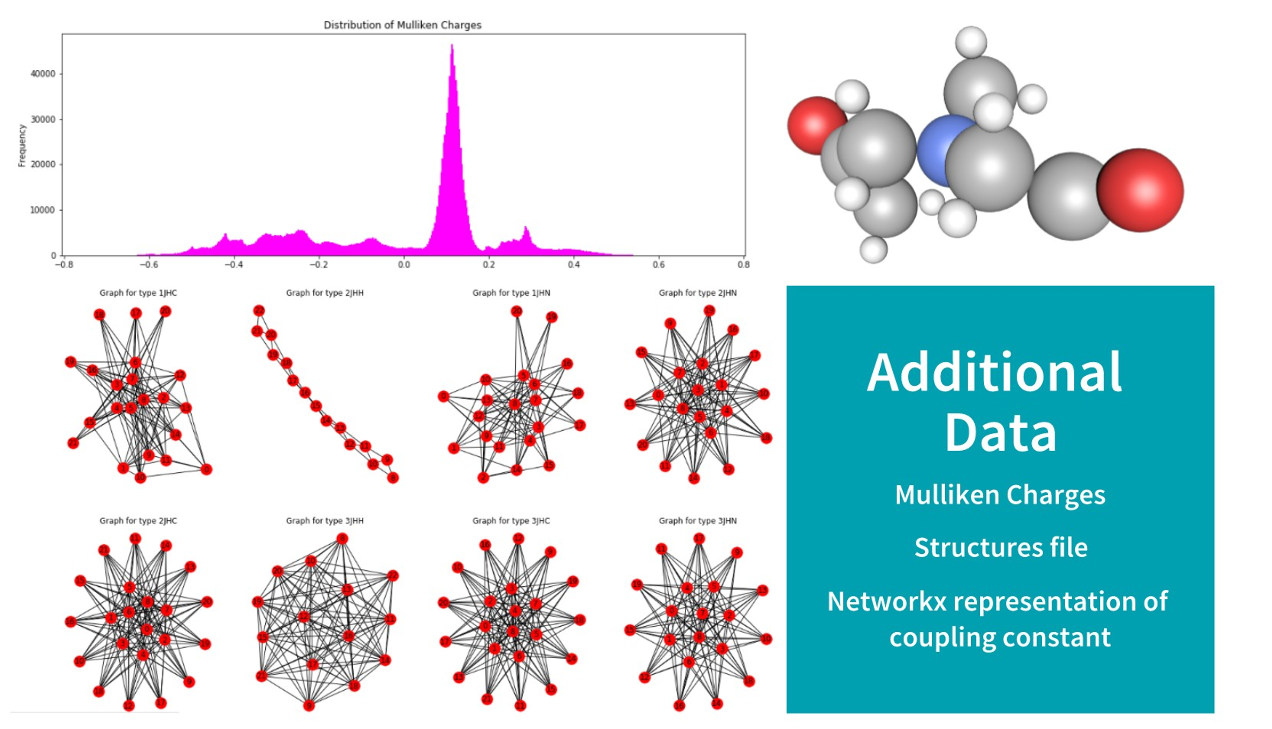

Slide 16
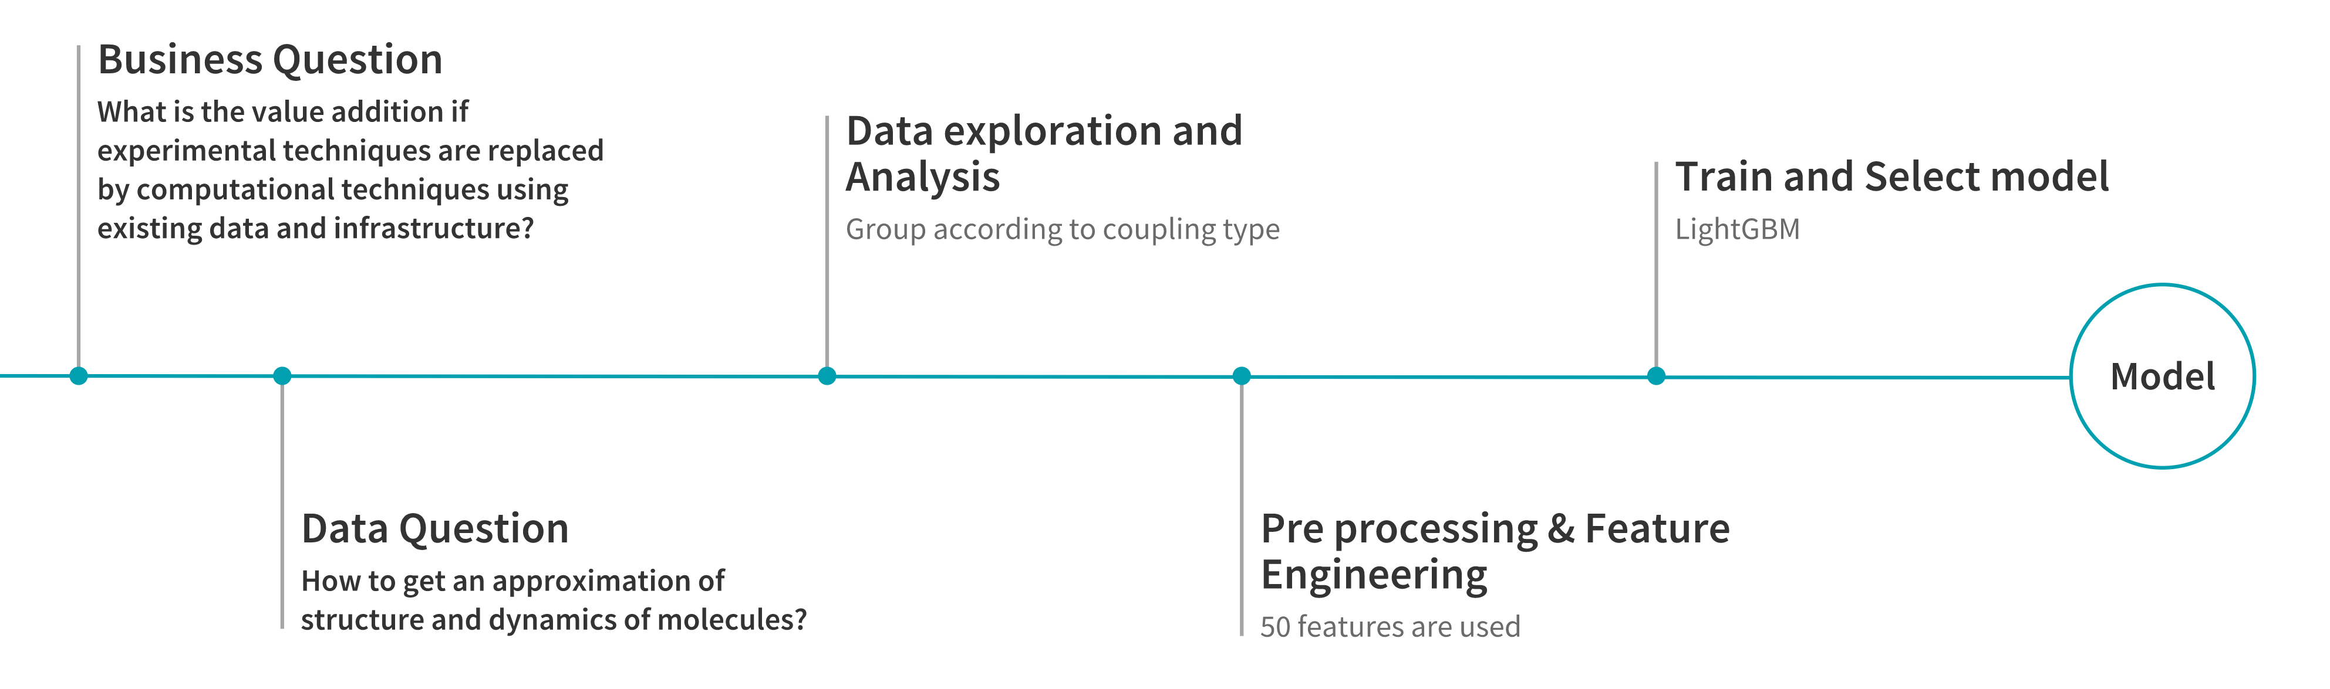
Data process flow

Slide 17
Scores: (-3.2 to 2), best score (100%) = -20
LightGBM Model | Scores (Log Mean Absolute Error)
1JHC | 0.2580
1JHN | -0.3887
2JHH | -1.1793
2JHC | -0.3525
2JHN | -0.9733
3JHH | -0.9914
3JHC | -0.2593
3JHN | -1.2427
Average score | -0.6

Slide 18
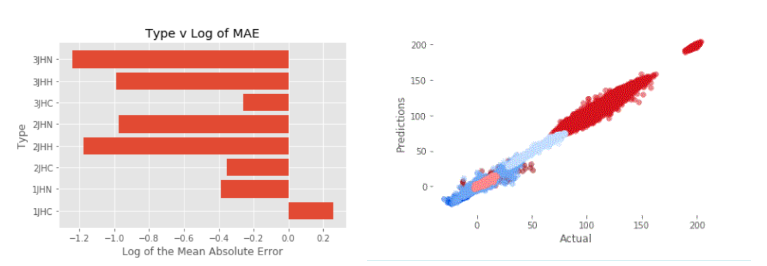
LightGBM Evaluation

Slide 19
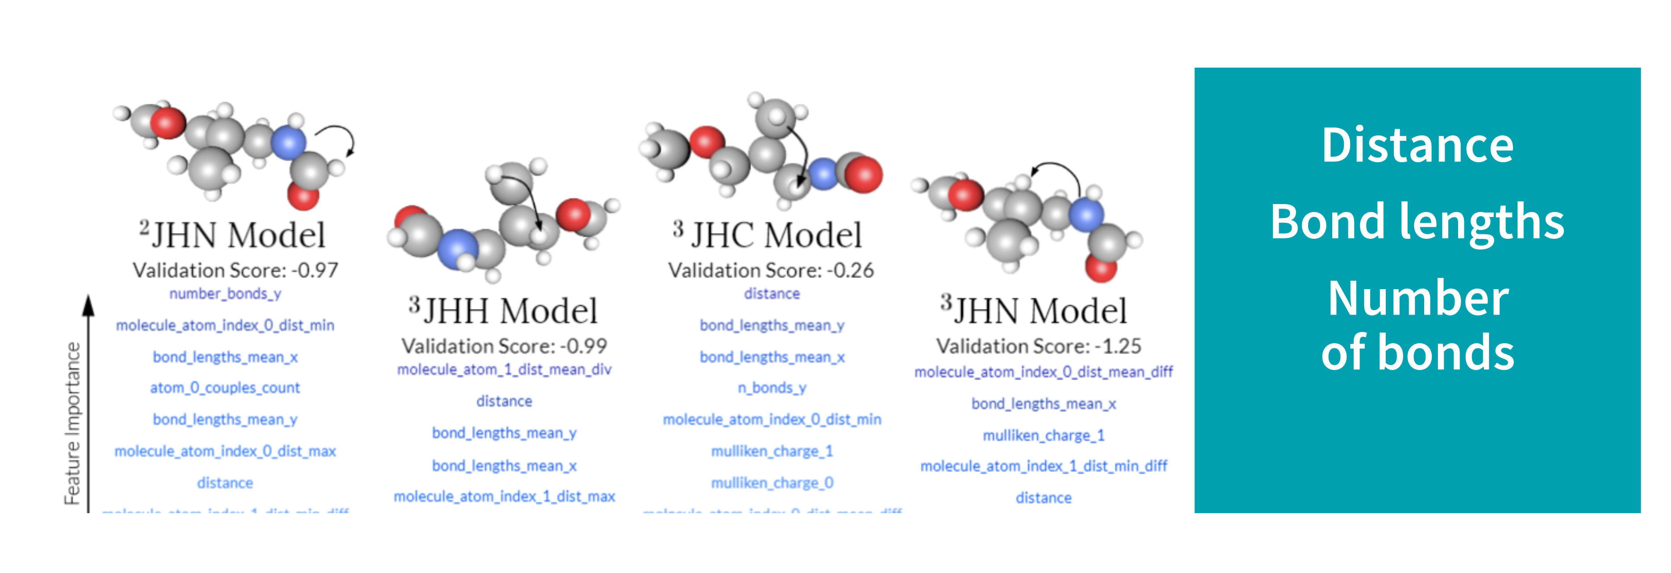
Feature importance

Slide 20
01
TABLE OF CONTENTS
BIO
02
Study objectives
03
Define, Design & Delivery
04
CONCLUSIONS
All my journey so far!
Molecular structure
Data analysis and design of the model
Summary & Next steps

Slide 21
Next Steps
Training with important features
Comparing with different ensemble models
Apply Neural Network
Fine Tuning

Slide 22
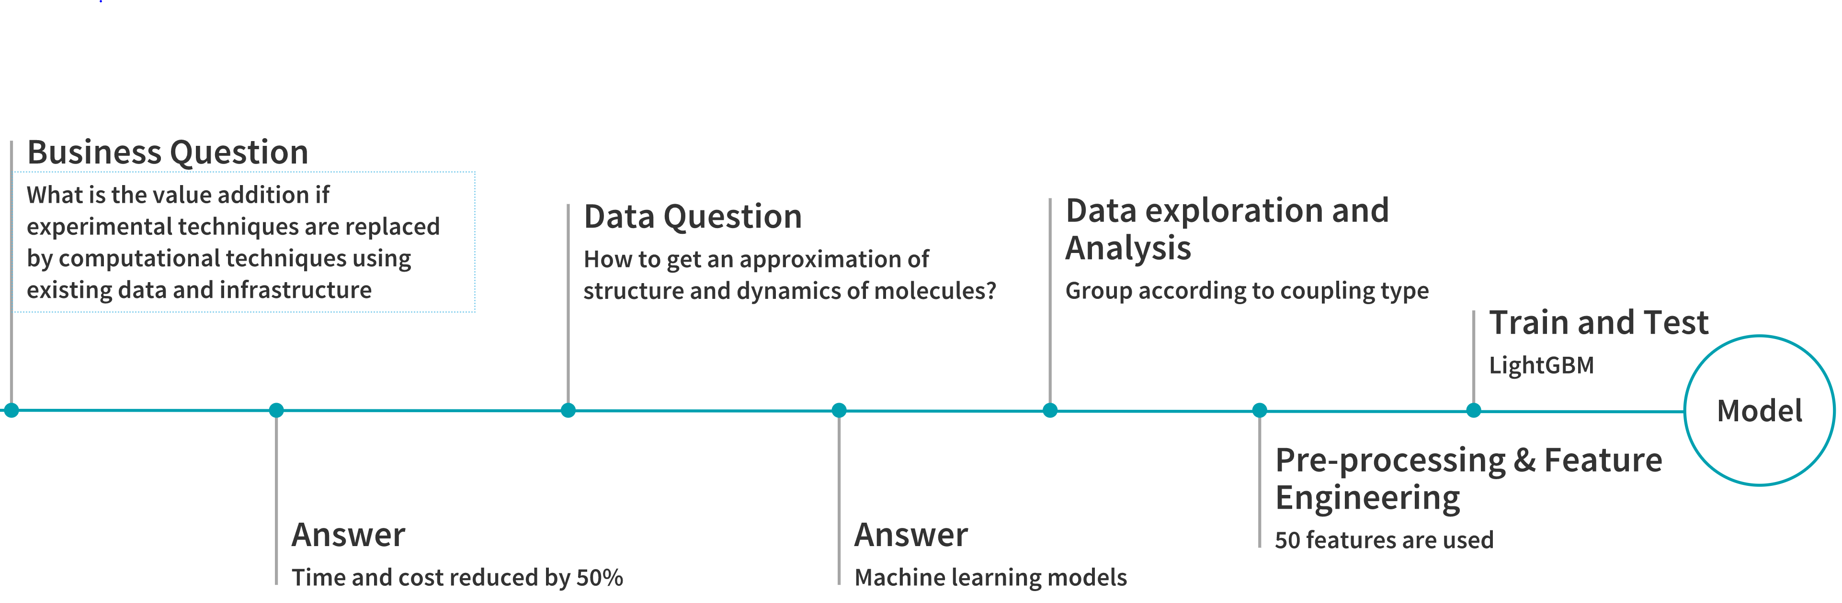
CONCLUSIONS

Slide 23
BIBLIOGRAPHY
GIT https://github.com/saritacharde/DSIA-SYD-FT-Projects-201907
Predicting NMR Parameters from the Molecular Structure, August 2014
https://www.kaggle.com/c/champs-scalar-coupling
https://www.kaggle.com/c/champs-scalar-coupling-constants-using-machine-learning

Slide 24
Thank You
Does anyone have any questions?
saritacharde04@gmail.com
+61 456 651 152

